Slide 1
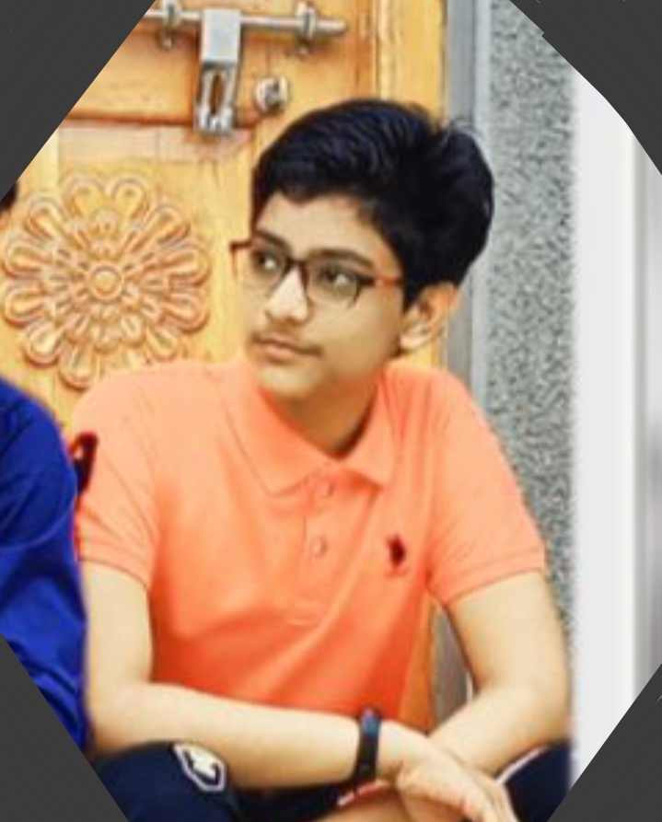
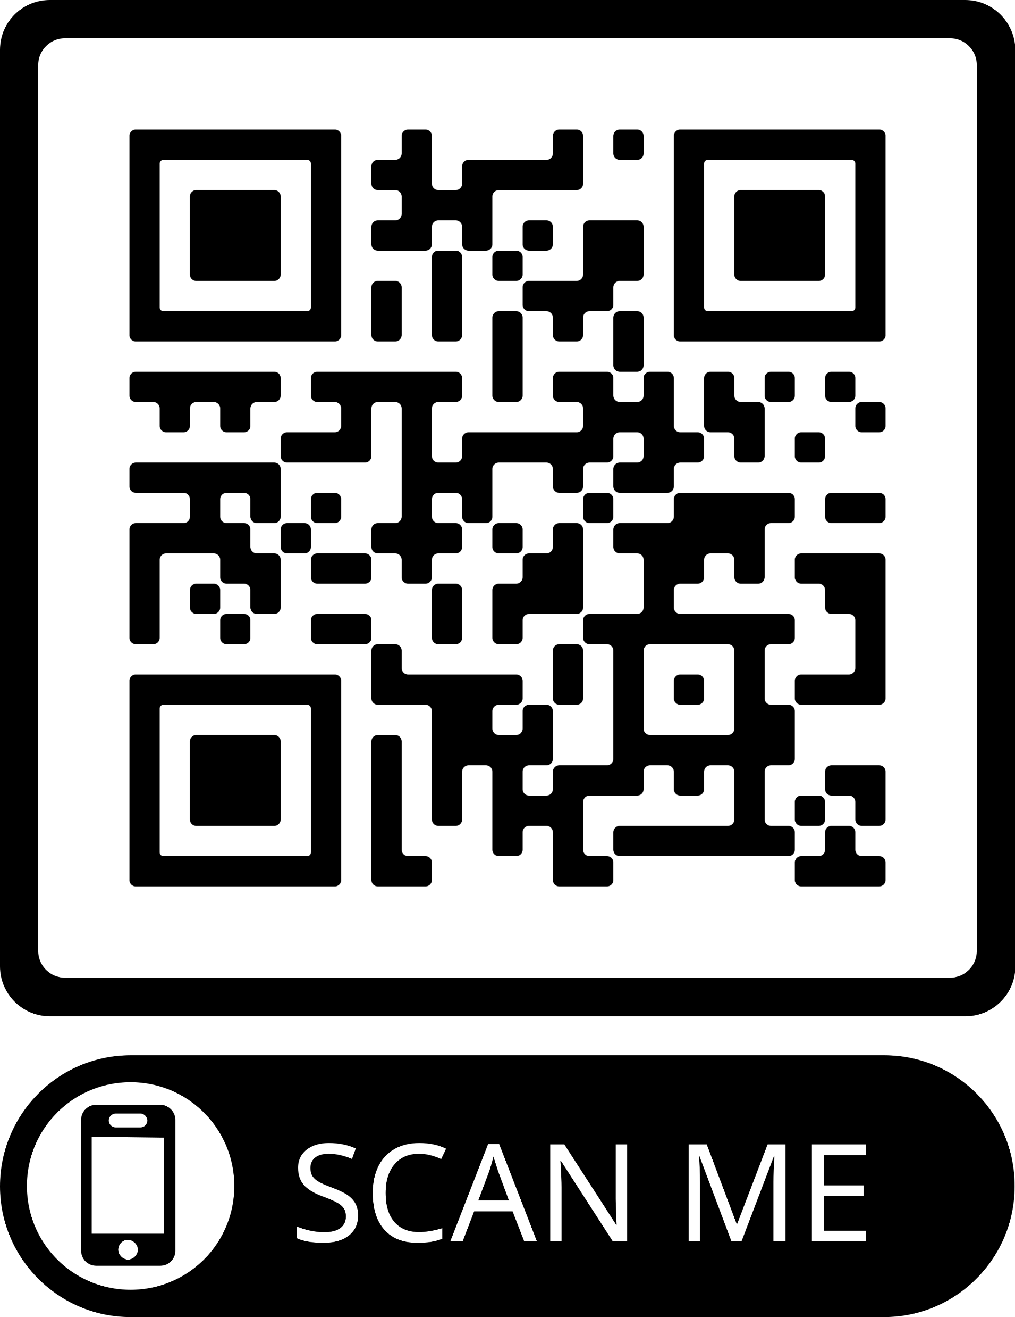






.
Making apps and games
MOHAMMAD SAAD
Whitehat junior Student
.
ABOUT ME …………………………………………………………………………………………………………………
SCAN ME……………………
HI I am Mohammad saad
PROJECTS………………………………………………………………………………………………………………….
Launch the app using the QR code above & scan the icons bellow to know more
About my AR VR Projects
HOBBIES ……………….….
SKILL…………………………………………………………………………………………………………………
BADGES EARNED …………
#javaScript #HTML #CSS #Python #ReactNative

